Slide 1
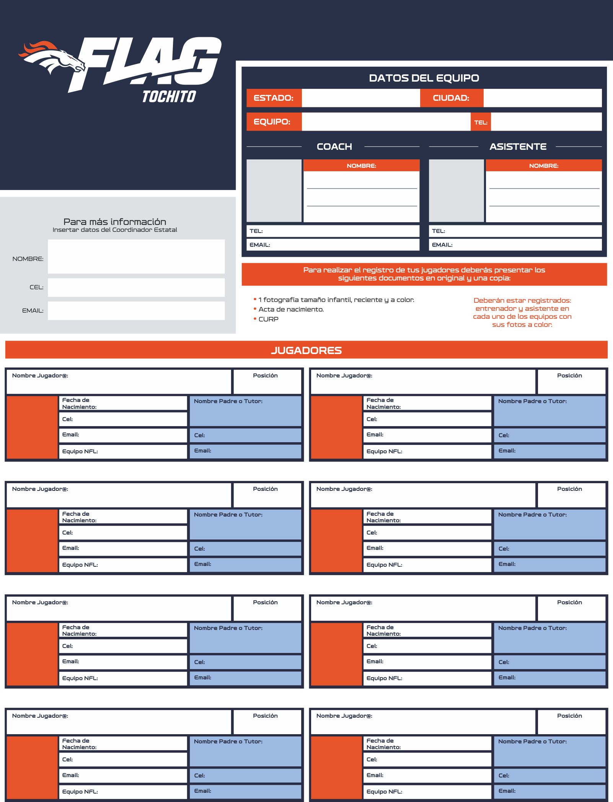
CATEGORÍA U-12 MIXTA
MORELOS
CUERNAVACA
LIGA
NFL FLAG TOCHITO
2024 - 2025
BOLT GRILLOS FLAG
55 1234 5678
ALEJANDRA PATRICIA
PORTILLO CASANOVA
ALEJANDRA PATRICIA
PORTILLO CASANOVA
55 1234 5678
55 1234 5678
ALEJANDRA PATRICIA PORTILLO CASANOVA
elcouch324@gmail.com
elcouch324@gmail.com
55 1234 5678
elcouch324@gmail.com
ALEJANDRA PATRICIA PORTILLO CASANOVA
CORNER / WR
ALEJANDRA PATRICIA PORTILLO CASANOVA
CORNER / WR
55 1234 5678
24 / 09 / 2010
ALEJANDRA PATRICIA
PORTILLO CASANOVA
55 1234 5678
24 / 09 / 2010
ALEJANDRA PATRICIA
PORTILLO CASANOVA
elcouch324@gmail.com
55 1234 5678
elcouch324@gmail.com
55 1234 5678
SAN FRANCISCO
elcouch324@gmail.com
SAN FRANCISCO
elcouch324@gmail.com
ALEJANDRA PATRICIA PORTILLO CASANOVA
CORNER / WR
ALEJANDRA PATRICIA PORTILLO CASANOVA
CORNER / WR
55 1234 5678
24 / 09 / 2010
ALEJANDRA PATRICIA
PORTILLO CASANOVA
55 1234 5678
24 / 09 / 2010
ALEJANDRA PATRICIA
PORTILLO CASANOVA
elcouch324@gmail.com
55 1234 5678
elcouch324@gmail.com
55 1234 5678
SAN FRANCISCO
elcouch324@gmail.com
SAN FRANCISCO
elcouch324@gmail.com
ALEJANDRA PATRICIA PORTILLO CASANOVA
CORNER / WR
ALEJANDRA PATRICIA PORTILLO CASANOVA
CORNER / WR
55 1234 5678
24 / 09 / 2010
ALEJANDRA PATRICIA
PORTILLO CASANOVA
55 1234 5678
24 / 09 / 2010
ALEJANDRA PATRICIA
PORTILLO CASANOVA
elcouch324@gmail.com
55 1234 5678
elcouch324@gmail.com
55 1234 5678
SAN FRANCISCO
elcouch324@gmail.com
SAN FRANCISCO
elcouch324@gmail.com
ALEJANDRA PATRICIA PORTILLO CASANOVA
CORNER / WR
ALEJANDRA PATRICIA PORTILLO CASANOVA
CORNER / WR
55 1234 5678
24 / 09 / 2010
ALEJANDRA PATRICIA
PORTILLO CASANOVA
55 1234 5678
24 / 09 / 2010
ALEJANDRA PATRICIA
PORTILLO CASANOVA
elcouch324@gmail.com
55 1234 5678
elcouch324@gmail.com
55 1234 5678
SAN FRANCISCO
elcouch324@gmail.com
SAN FRANCISCO
elcouch324@gmail.com

